Slide 1

20th January 2026
PROJECT ON BIKE SHARING DEMAND ANALYSIS
Submit by ANSHPREET SINGH LAMBA

Slide 2
Project Overview
Three datasets merged: calendar, weather, and rental demand
Data cleaned and consolidated into a single Excel workbook
Prepared for pivot analysis, dashboarding, and automation

Slide 3
Key Variables
Temporal: season, yr, mnth, hr, weekday, holiday
Weather: weathersit, temp, atemp, hum, windspeed
Demand: casual, registered, cnt (total rentals)

Slide 4

Data Cleaning Steps
Removed duplicate rows
Handled missing values using column averages
Corrected data types (dates, integers, floats)

Slide 5

Calculated Columns
Weekend vs Weekday: based on weekday column
Holiday Flag: derived from holiday column

Slide 6
Pivot Table Insights
Rental demand peaks during morning and evening hours
Weather condition impacts rental volume
Registered users dominate during weekdays; casual users on weekends

Slide 7
Statistical Analysis
Positive correlation between temperature and rental demand
Higher variability in casual users compared to registered users
Humidity and windspeed show moderate negative correlation with demand

Slide 8
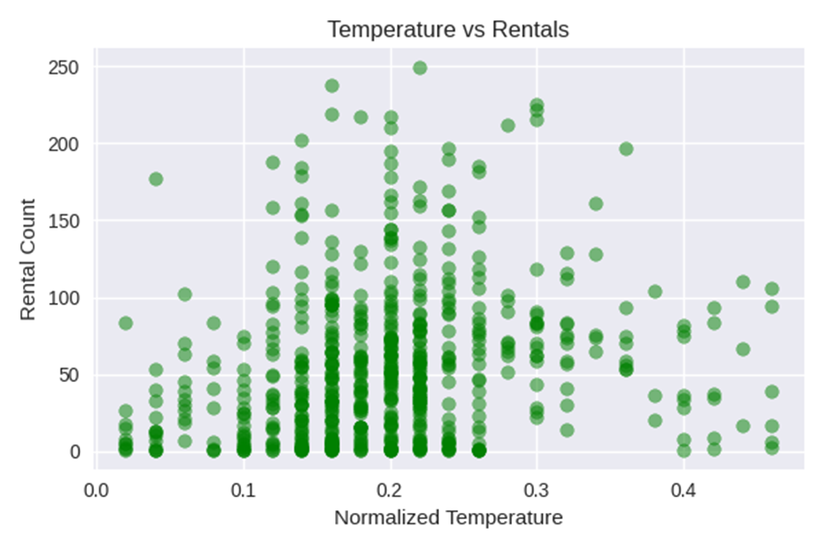
Dashboard Elements
Line chart: rentals by hour
Bar chart: rentals by weather condition
Heatmap: weekday vs hour
Slicers: season, user type, weather
Timeline: date-based filtering

Slide 9
VBA Automation
Macro to auto-refresh all pivot tables and data connections
Ensures up-to-date dashboards with one click
Improves usability for business users

Slide 10
Recommendations & Conclusion
Use forecasting to predict future demand trends
Monitor anomalies in rental patterns for operational planning
Leverage dashboards for data-driven decision making

